Slide 1
Process

Slide 2
First Principles
Traits of Successful Projects
Existence of a strong architectural vision
well-defined layers of abstraction
clear separation of concerns between the interface and implementation of each layer
simple
Application of a well-managed iterative and incremental development lifecycle
functionality of the system is developed in a successive series of releases (iterative) of increasing completeness (incremental)

Slide 3
First Principles
advantages of an iterative/ evolutionary development approach
Requirements changes are accommodated
no “big bang” integration effort
Risks are addressed early
Tactical changes to the product are possible
Reuse is facilitated
Defects can be found earlier and corrected
Project personnel are employed more effectively
Team members learn along the way
The development process can be refined and improved

Slide 4
Toward a Rational Development Process
agile processes
Lightweight and sparse, less ceremony
Reliant on the tacit knowledge of the team members
Tactically focused rather than strategic
Iterative and incremental
Heavily reliant on customer collaboration
Self-organizing and managing
Emergent as opposed to predetermined

Slide 5
Toward a Rational Development Process
plan-driven processes
More heavyweight, more ceremony
Reliant on well-documented processes
Strategically focused rather than tactically focused
Reliant on a customer contract
Managed and controlled
Defined up front and then continually improved

Slide 6
The Macro Process: The Software Development Lifecycle
RUP lifecycle
Two dimensions, content and time—what is done and when it is done

Slide 7
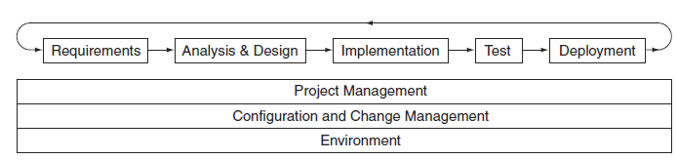
The Macro Process Content Dimension— Disciplines

Slide 8
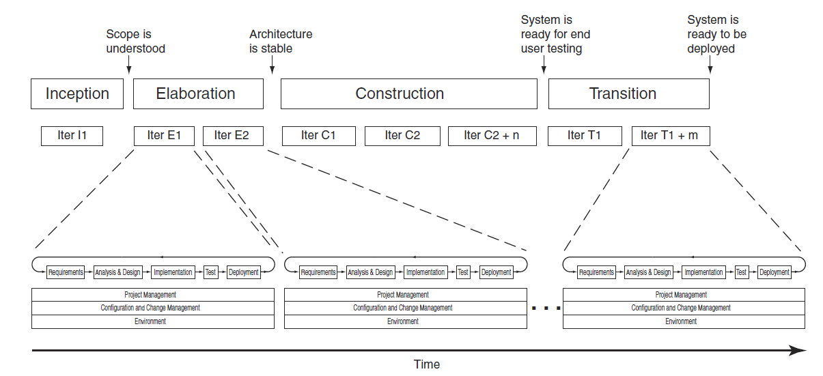
The Macro Process Time Dimension— Milestones and Phases

Slide 9
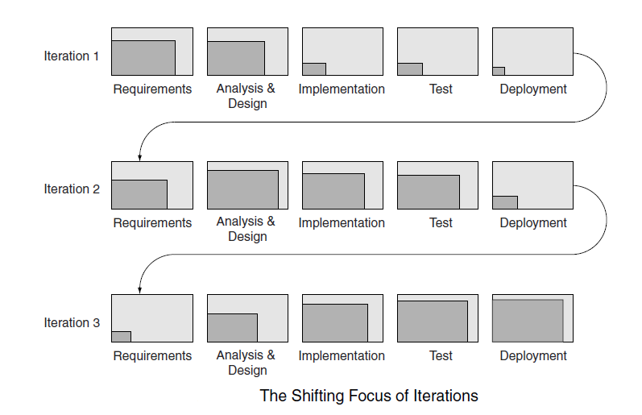
The Macro Process Time Dimension— Iterations

Slide 10
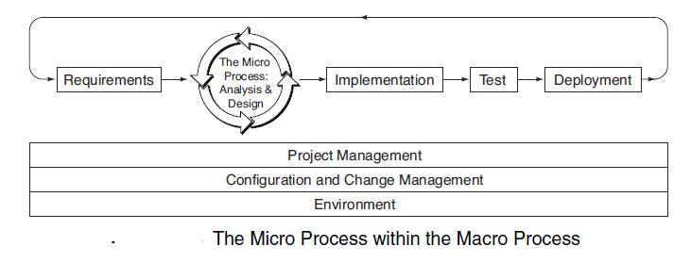
The Micro Process: The Analysis and Design Process

Slide 11
The Micro Process: The Analysis and Design Process
two key dimensions—levels of abstraction and content (activities and work products)

Slide 12
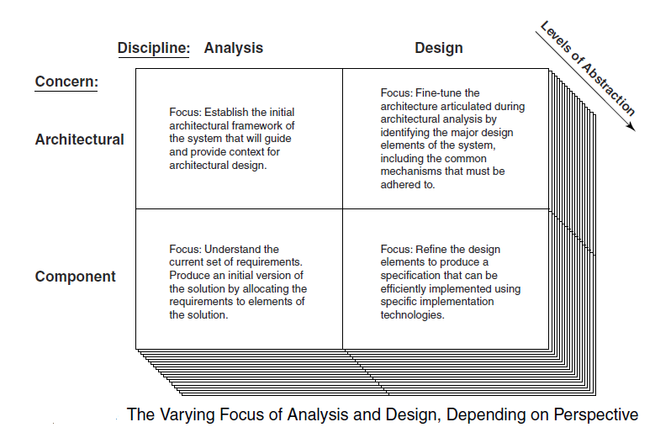
Levels of Abstraction

Slide 13
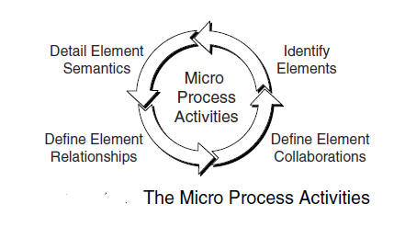

Slide 14
